Slide 1
Management Information System
Final Year ILE

Slide 2
What Do Information Systems Have to Do with Business?
How information systems provide the foundation for modern business enterprises.
How real global businesses use technology and information systems to increase their profitability, gain market share, improve their customer service, and manage their daily operations.

Slide 3
Syllabus
Organizational Strategy, Competitive Advantage
Ethics and Privacy
Information Security
Data and Knowledge Management
Telecommunications and Networking
E-Business and E-Commerce
Mobile Computing, and Mobile Commerce
Social Computing
CR Management and Supply Chain Management

Slide 4
Homo Conexus
You are the most connected generation in history
You practice continuous computing
You are surrounded by a personal, movable information network

Slide 5
Homo Conexus
Your personal information network is created by constant cooperation between:
(1) the digital devices you carry;
(2) the wired and wireless networks that you access as you move about;
(3) Web-based tools for finding information and communicating and collaborating with other people.

Slide 6
Introduction To Information Systems
Identify the reasons why being an informed user of information systems is important in today’s world.
Describe the various types of computer-based information systems in an organization.
Discuss ways in which information technology can affect managers and non-managerial workers.
Identify positive and negative societal effects of the increased use of information technology.

Slide 7
Information Systems: Concepts and Definitions
Data Item. Elementary description of things, events, activities and transactions that are recorded, classified and stored but are not organized to convey any specific meaning.
Information. Data organized so that they have meaning and value to the recipient.
Knowledge. Data and/or information organized and processed to convey understanding, experience, accumulated learning and expertise as they apply to a current problem or activity.

Slide 8
Data items can be numbers, letters, figures, sounds, and images. Examples of data items are collections of numbers (e.g., 3.11, 2.96, 3.95, 1.99, 2.08) and characters (e.g., B, A, C, A, B, D, F, C).
A grade point average (GPA) by itself is data, but a student’s name coupled with his or her GPA is information. The recipient interprets the meaning and draws conclusions and implications from the information. Consider the examples of data provided in the preceding paragraph. Within the context of a university, the numbers could be grade point averages, and the letters could be grades in an Introduction to MIS class.
For example, suppose that a company recruiting at your college has found over time that students with grade point averages over 3.0 have experienced the greatest success in its management program. Based on this accumulated knowledge, that company may decide to interview only those students with GPAs over 3.0.

Slide 9
Data | Information | Knowledge
[No context] | [University context]
3.16 | 3.16 + John Jones = GPA | * Job prospects
2.92 | 2.92 + Sue Smith = GPA | * Graduate school prospects
4.39 | 4.39 + Kyle Owens = GPA | * Scholarship prospects
3.95 | 3.95 + Tom Elias = GPA
[No context] | [Professional baseball pitcher context]
3.16 | 95 3.16 + Ken Rice = ERA
2.92 | 2.92 + Ed Dyas = ERA | * Keep pitcher, trade pitcher, or send pitcher to minor leagues
1.39 | 1.39 + Hugh Carr = ERA | * Salary/contract negotiations
3.95 | 3.95 + Nick Ford = ERA
GPA = grade point average (higher is better).
ERA = earned run average (lower is better); ERA is the number of runs per nine innings that a pitcher surrenders.

Slide 10
Define information technology (IT) and information systems (IS).
Information technology refers to any computer-based tool that people use to work with information and to support the information and information-processing needs of an organization.
An information system collects, processes, stores, analyzes, and disseminates information for a specific purpose
IT has transformed modern organizations, individuals and societies, the global economy, and our physical environment. In addition, IT is making our world smaller, enabling more and more people to communicate, collaborate, and compete, thereby levelling the digital playing field.

Slide 11
When you graduate, you will either start your own business or work for an organization, whether it is public sector, private sector, for-profit, or not-for-profit.
Your organization will have to survive and compete in an environment that has been radically transformed by information technology.
This environment is global, massively interconnected, intensely competitive, 24/7/365, real-time, rapidly changing, and information-intensive. To compete successfully, your organization must use IT effectively

Slide 12
The Informed User—You!
Why you should learn about information systems and information technologies?
First, you will benefit more from your organization’s IT applications because you will understand what is “behind” those applications.
Second, you will be in a position to enhance the quality of your organization’s IT applications with your input.
Third, even as a new graduate, you will quickly be in a position to recommend—and perhaps help select—the IT applications that your organization will use.
Fourth, being an informed user will keep you abreast of both new information technologies and rapid developments in existing technologies. Remaining “on top of things” will help you to anticipate the impacts that “new and improved” technologies will have on your organization and to make recommendations on the adoption and use of these technologies.
Fifth, you will understand how using IT can improve your organization’s performance and teamwork as well as your own productivity.
Finally, if you have ideas of becoming an entrepreneur, then being an informed user will help you use IT when you start your own business.

Slide 13

MIS provides what users see on their computer screens.
USERS MIS

Slide 14
Managing information systems in modern organizations is a difficult, complex task – why?
Several factors contribute to this complexity.
First, information systems have enormous strategic value to organizations. Firms rely on them so heavily that, in some cases, when these systems are not working (even for a short time), the firm cannot function.
Second, information systems are very expensive to acquire, operate, and maintain.
A third factor contributing to the difficulty in managing information systems is the evolution of the management information systems (MIS) function within the organization.

Slide 15
Differentiate between Traditional and modern functions of MIS

Slide 16
Concepts and Definitions
Information Technology Architecture. A high-level map or plan of the information assets in an organization, which guides current operations and is a blueprint for future directions.
Information Technology Infrastructure. The physical facilities, IT components, IT services and IT management that support an entire organization.

Slide 17
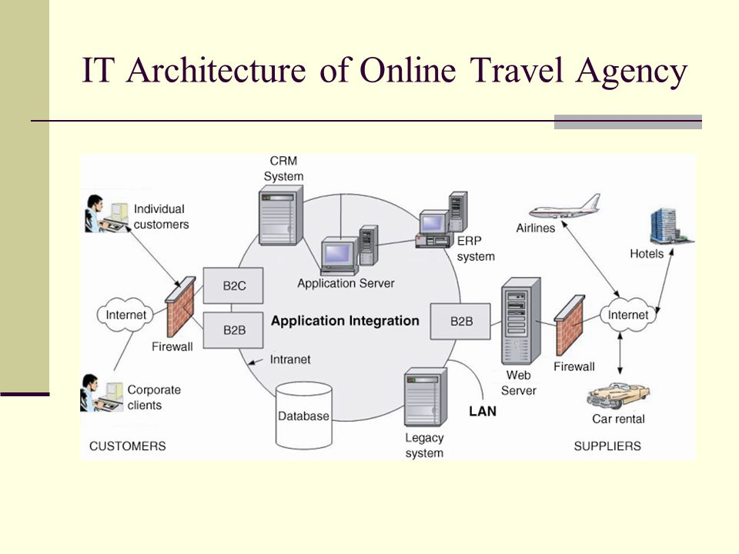

Slide 18
IT Components, IT Platform, IT Services, and IT Infrastructure
IT components consist of hardware, software, telecommunications and networks, and wireless communications.
IT services consist of data management, managing security and risk, and systems development.
IT personnel use IT components to produce IT services .
IT infrastructure consists of IT components, IT personnel, and IT services.

Slide 19
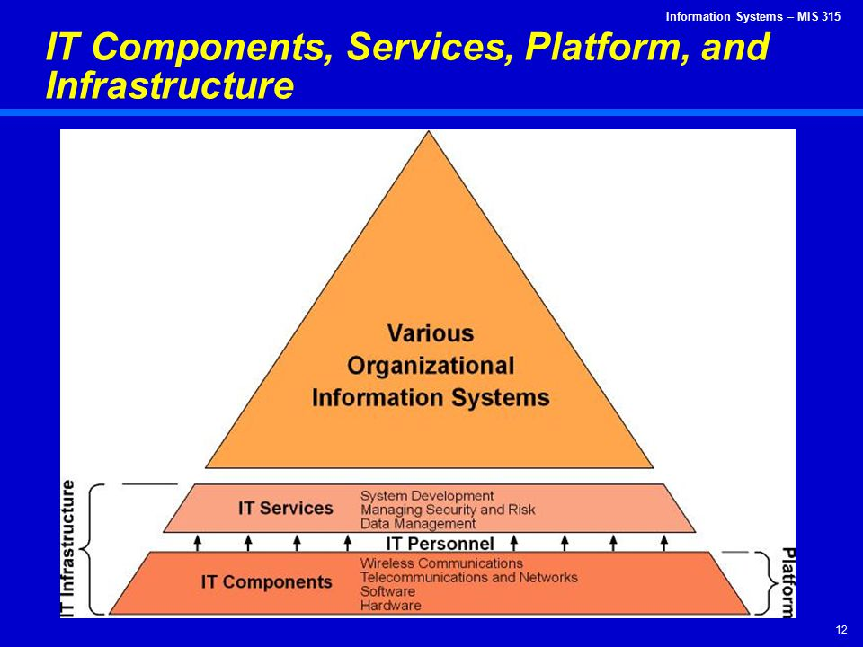

Slide 20
Components of MIS
• Hardware consists of devices such as the processor, monitor, keyboard, and printer. Together, these devices accept, process, and display data and information.
• Software is a program or collection of programs that enable the hardware to process data.
• A database is a collection of related files or tables containing data.
• A network is a connecting system (wired or wireless) that permits different computers to share resources.
• Procedures are the instructions for combining the above components to process information and generate the desired output.
• People are those individuals who use the hardware and software, interface with it, or utilize its output.

Slide 21
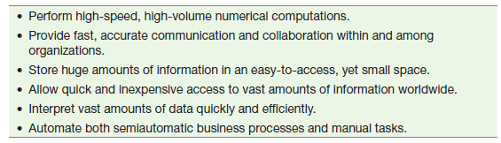
Overview of Computer-Based Information Systems
A computer-based information system is an information system that uses computer technology to perform some or all of its intended tasks.
Computer-based information systems have many capabilities. Some of them are listed below:

Slide 22
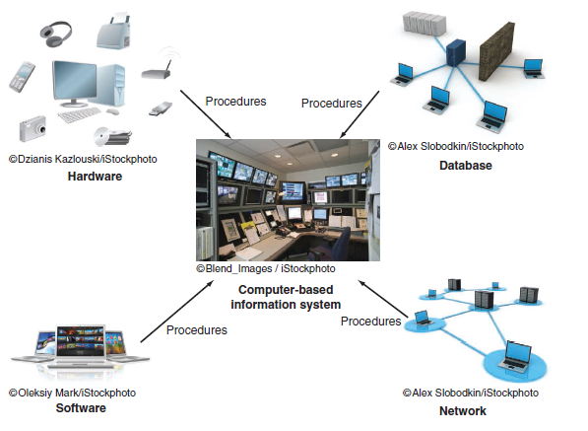

Slide 23
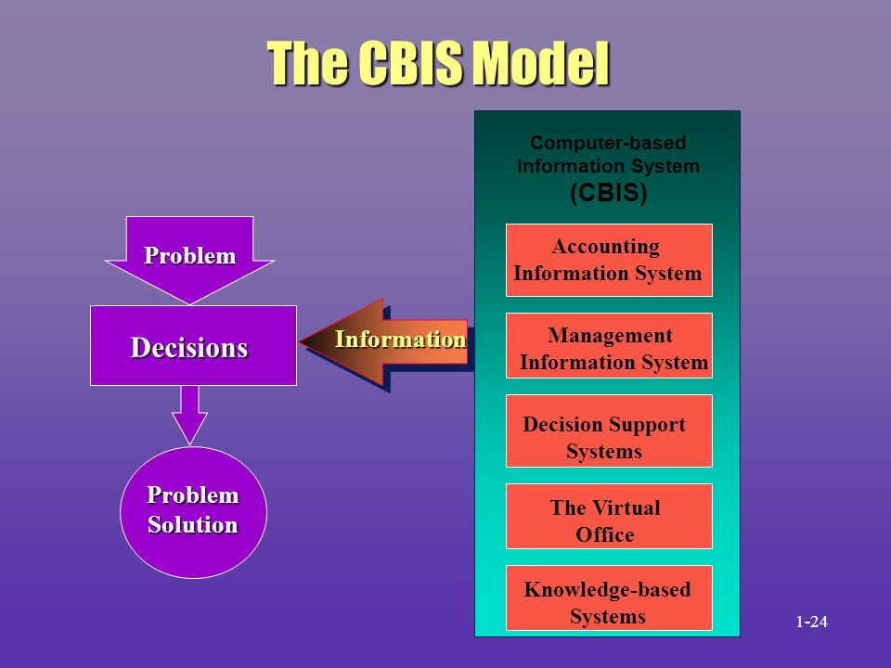

Slide 24
Types of Computer-Based Information Systems
Modern organizations employ many different types of information systems.
Transaction processing systems (TPSs),
Management information systems, (MIS) and
Enterprise resource planning (ERP) systems
customer relationship management (CRM) systems
and supply chain management (SCM) systems
24
2020-2021
17-07-2020

Slide 25
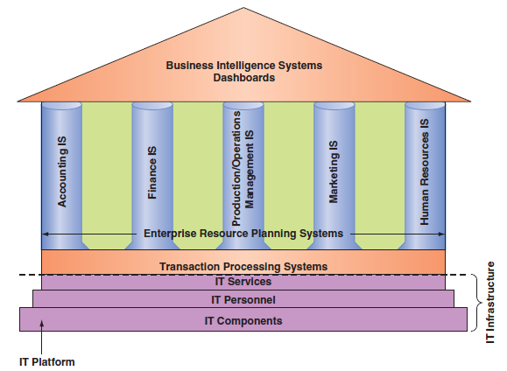

Slide 26
Information systems perform various tasks via a wide spectrum of applications:
An application (or app) is a computer program designed to support a specific task or business process. Each functional area or department within a business organization uses dozens of application programs.
The collection of application programs in a single department is usually referred to as a departmental information system (also known as a functional area information system (FAIS))
For example, the collection of application programs in the human resources area is called the human resources information system (HRIS).
Departmental information systems—in the other functional areas as well, such as accounting, finance, marketing, and production/operations.

Slide 27
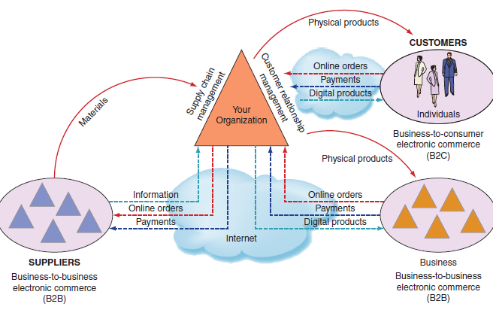
Information systems that function among multiple organizations.

Slide 28
FAIS
Consider some examples of IT systems in the various functional areas of an organization.
Why managers use IT in finance and accounting?
Why managers use IT in sales department?
Why managers use IT in marketing department?
Why managers use IT in HR department?

Slide 29
A transaction processing system (TPS)
Supports the monitoring, collection, storage, and processing of data from the organization’s basic business transactions, each of which generates data.
When you are checking out at DMart, for example, a transaction occurs each time the cashier swipes an item across the bar code reader.
A transaction is anything that changes the firm’s database.
Consider a scenario in which a student transfers from one section of an Introduction to MIS course to another section. This move would be a transaction to the university’s information system, but not to the university’s accounting department (the tuition would not change).
The TPS collects data continuously, typically in real time, that is, as soon as the data is generated and it provides the input data for the corporate databas
TPSs are considered critical to the success of any enterprise because they supes. port core operations.

Slide 30
Enterprise Resource Planning (ERP)
Enterprise Resource Planning is software that integrates all departments and functions across a business into a single system while still serving each department’s specific needs. It is designed to help businesses make smarter decisions, serve their customers better, and work more efficiently overall by automating processes and workflows.
ERP software is important because it can facilitate the following:
Increase effective communication between departments
Allow employees to access information they need from anywhere
Streamline processes across various department
Provide a bird’s eye view of a business' overall operations
Better manage a company's finances

Slide 31
ERP ...
ERP can be beneficial from a marketing standpoint because it helps you
see how your business is doing as a whole
reveal areas of opportunity where improvements can be made.
provides valuable data and analytics that will help you understand your customers better
will give you insight that you can use to tailor your marketing strategy.
It also makes it easier to communicate effectively with your customers and provide better customer service.

Slide 32
Other systems
ERP systems and TPSs function primarily within a single organization.
Information systems that connect two or more organizations are referred to as interorganizational information systems (IOSs)
IOSs support many interorganizational operations, of which supply chain management is the best known.
An organization’s supply chain is the flow of materials, information, money, and services from suppliers of raw materials through factories and warehouses to the end customers.
Information flows, financial flows, and digitizable products go through the Internet, whereas physical products are shipped.

Slide 33
Other systems …
Electronic commerce systems are another type of interorganizational information system.
Office automation systems (OASs) typically support the clerical staff, lower and middle managers, and knowledge workers.
Business intelligence systems provide computer-based support for complex, non-routine decisions, primarily for middle managers and knowledge workers.
These employees use OASs to develop documents (word processing and desktop publishing software), schedule resources (electronic calendars), and communicate (e-mail, voice mail, videoconferencing, and groupware)
These systems enable organizations to conduct transactions, called business-to-business (B2B) electronic commerce, and customers to conduct transactions with businesses, called business to-consumer (B2C) electronic commerce. E-commerce systems typically are Internet based.

Slide 34
Other systems
Expert systems (ES) attempt to duplicate the work of human experts by applying reasoning capabilities, knowledge, and expertise within a specific domain.
They have become valuable in many application areas, primarily but not exclusively areas involving decision making. For example, navigation systems use rules to select routes, but we do not typically think of these systems as expert systems. Significantly, expert systems can operate as standalone systems or be embedded in other applications.
.
Dashboards (also called digital dashboards) are a special form of IS that support all managers of the organization. They provide rapid access to timely information and direct access to structured information in the form of reports. Dashboards that are tailored to the information needs of executives are called executive dashboards

Slide 36
Support for Organizational Employees
Clerical workers, who support managers at all levels of the organization, include bookkeepers, secretaries, electronic fi le clerks, and insurance claim processors.
Lower level managers handle the day-to-day operations of the organization, making routine decisions such as assigning tasks to employees and placing purchase orders.
Middle managers make tactical decisions, which deal with activities such as short-term planning, organizing, and control.
Knowledge workers are professional employees such as financial and marketing analysts, engineers, lawyers, and accountants. All knowledge workers are experts in a particular subject area. They create information and knowledge, which they integrate into the business. Knowledge workers, in turn, act as advisors to middle managers and executives.
Executives make decisions that deal with situations that can significantly change the manner in which business is done.

Slide 37
How Does IT Impact Organizations?
IT Impacts Entire Industries: Software is impacting every industry, and every organization must prepare for these impacts
As of now, the technology required to transform industries through software had been developed and integrated and could be delivered globally.
Software tools and Internet-based services enabled companies in many industries to launch new software- powered startups without investing in new infrastructure or training new employees.
A few examples of software disruption across several industries.
Many of these examples focus on two scenarios:
(1) industries where software disrupted the previous market-leading companies and
(2) industries where a new company (or companies) used software to achieve a competitive advantage.

Slide 38
How Does IT Impact Organizations?
The book industry:
The music industry:
The video industry:
The software industry:
The videogame industry:
The photography industry:
The marketing industry:
The recruiting industry:
The financial services industry:
The motion picture industry:

Slide 39
How Does IT Impact Organizations?
Software is also disrupting industries that operate primarily in the physical world. Consider these examples:
The automobile industry:
The agriculture industry:
National defense:
The fashion industry:
Education:
The legal profession:

Slide 40
Questions
What is a computer-based information system?
Describe the components of computer-based information systems.
What is an application program?
Explain how information systems provide support for knowledge workers.
As we move up the organization’s hierarchy from clerical workers to executives, how does the type of support provided by information systems change?
How IT impacts the society?/ List positive and negative societal effects of the increased use of information technology.

